Slide 1
01/03/24
Tkinter

Slide 2
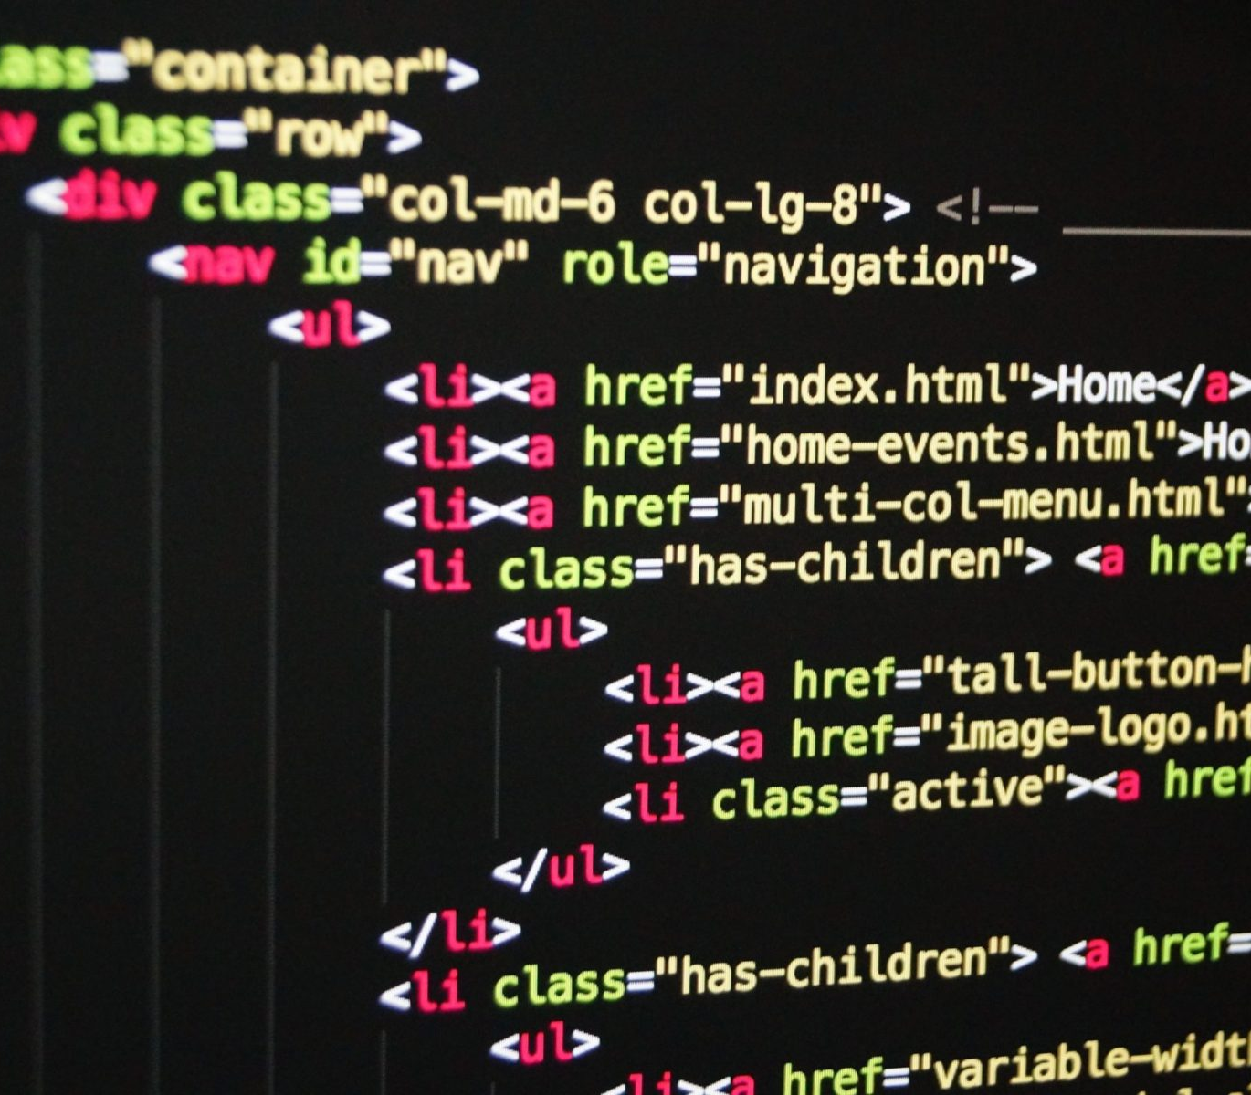
Front End Programming
Involves:
The Style:
Font
Size
Feel…
Accessibility
Speed:
It not being slow as dog poo

Slide 3
Front END Programming Languages
HTML
CSS
Javascript
React (Javascript library)
Vue
Angular
Swift
Django
HTML is simplest but not always regarded as a programming language
Javascript/React is the most popular
WARNING:
These languages are mostly for webpages and not for applications

Slide 4
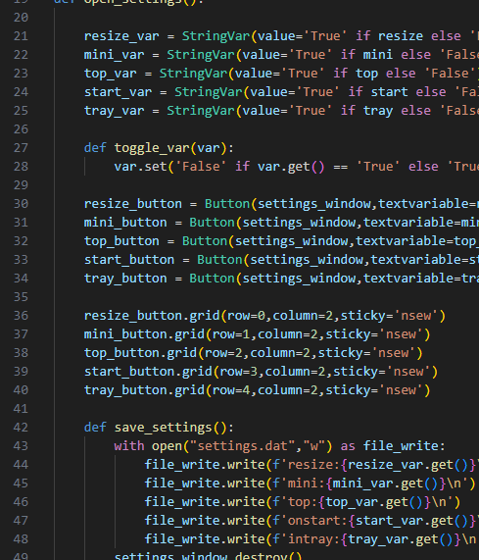
TKINTER
In Python
Simpler
Some constraints (restrictions)
There are other libraries but none are as comprehensive as Tkinter.

Slide 5
TODAY
Create a window
Add a button
Make the button do something
Explore other features…
You will be introduced to pip
You will also be introduced to PyPi.org

Slide 6
FINAL Note…
The Back-End of the app (algorithms etc.)
The Front-End of the app (GUI)
If you do want to do the algorithms as well feel free

Slide 7
More Things To aDD
Measured in Pixels or Characters

Slide 8

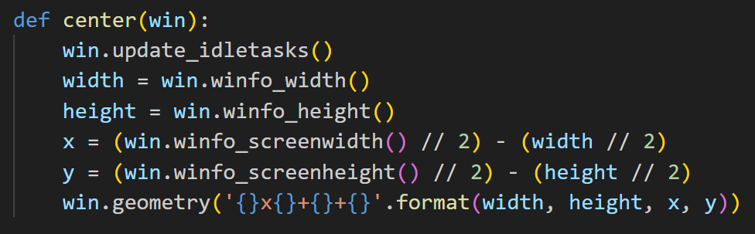
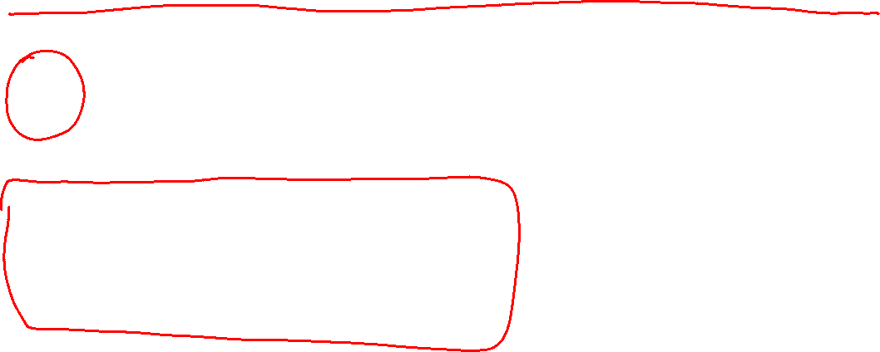
Things I will send you on Outlook
Command Prompt command line:
python -m pip install --trusted-host pypi.org --trusted-host files.pythonhosted.org #Library_Name#
Image file:
Centre screen python function:
Change this to the name of the library.

Slide 9
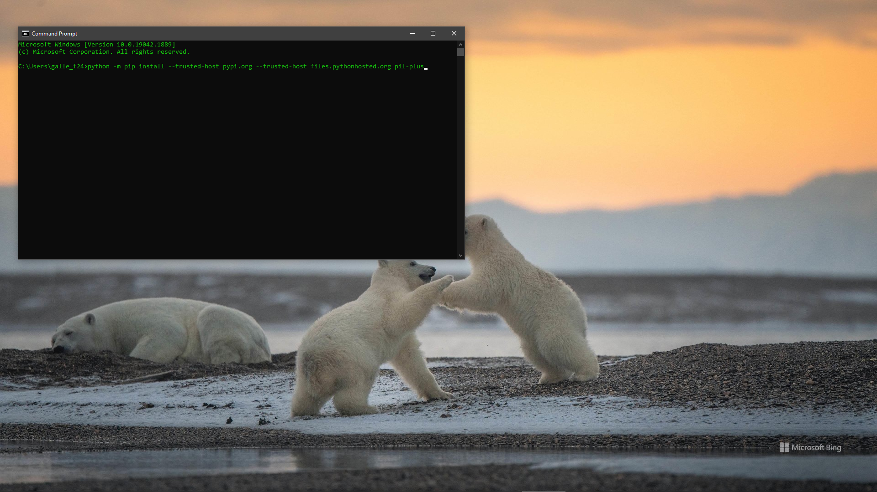
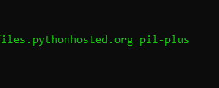
The name of the Library I

Slide 10
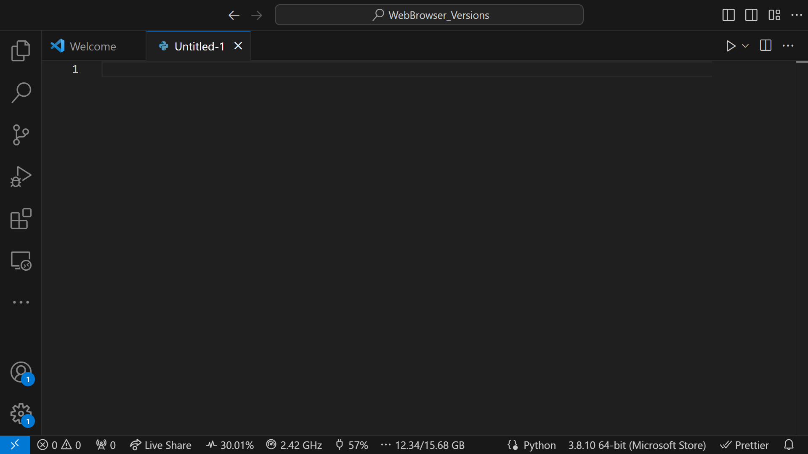

Slide 11
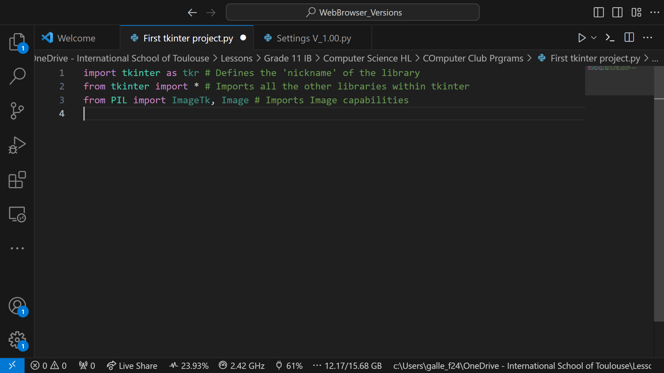

Slide 12
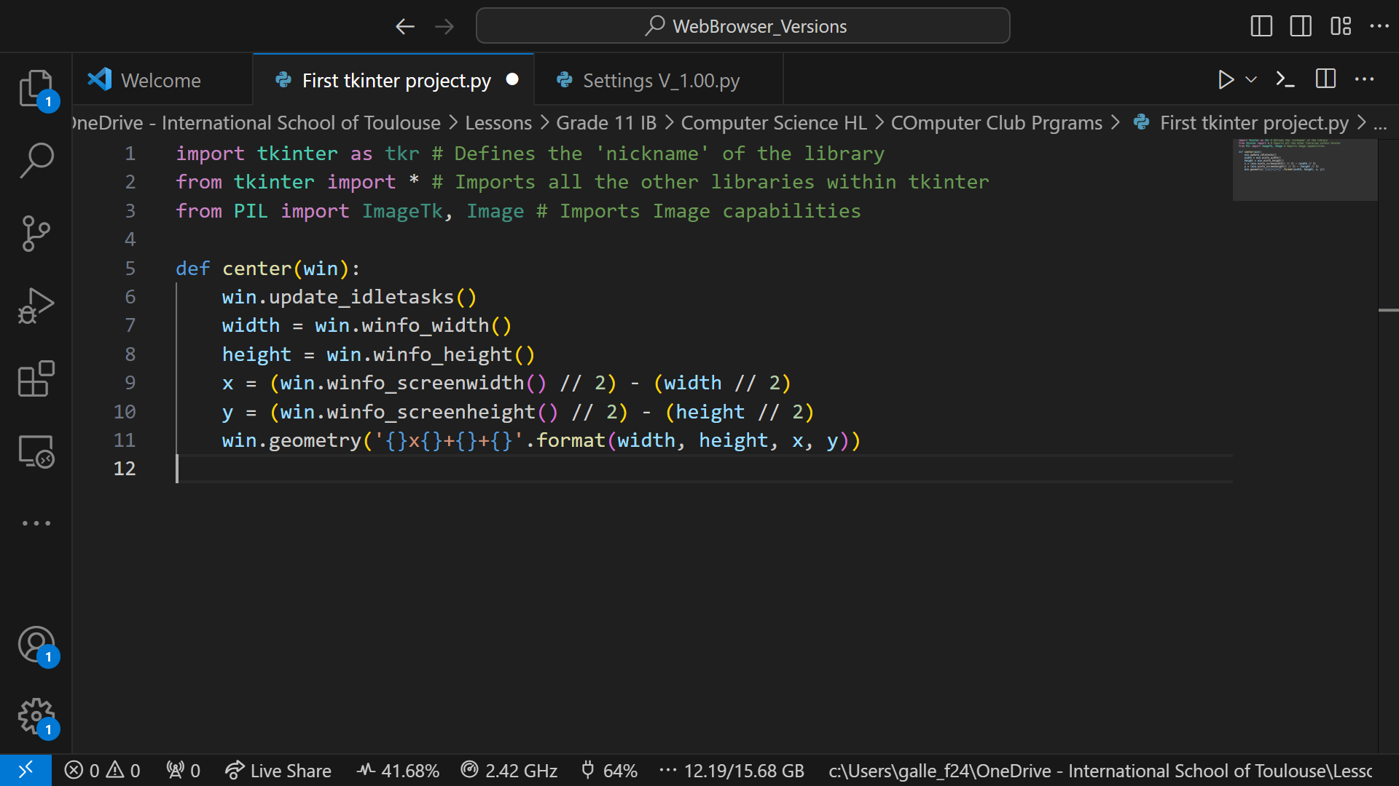
I will send you this snippet of code via outlook. You don’t have to use it, but it is a quick way to get the app centred on your screen

Slide 13
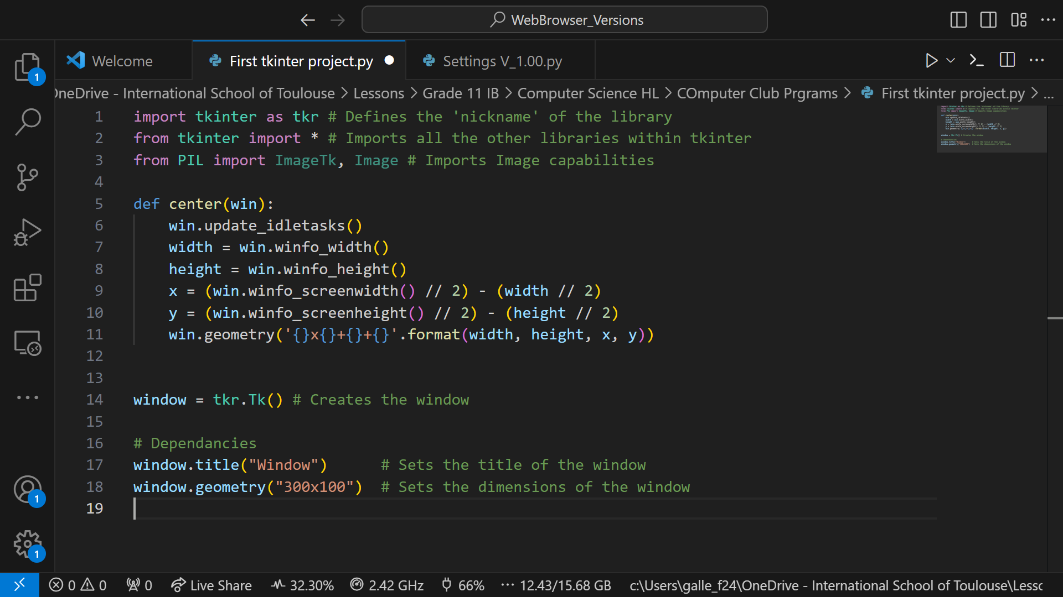
These are the main dependencies, there are others…

Slide 14
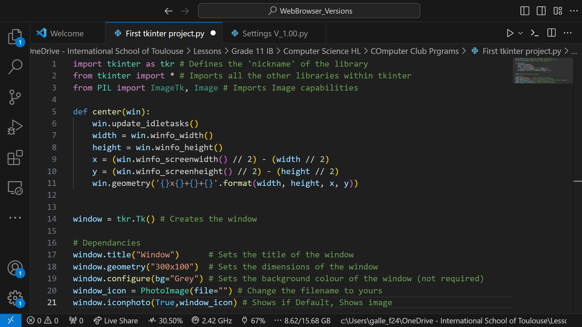
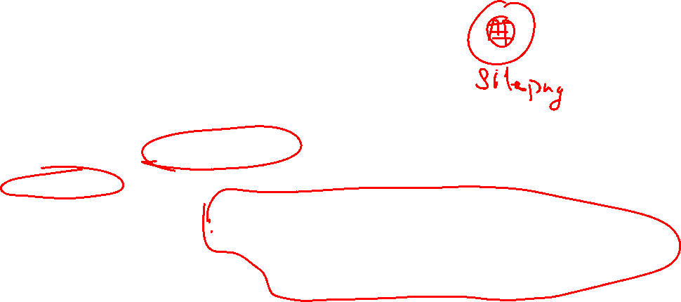

Slide 15
You can remove this space…

Slide 16
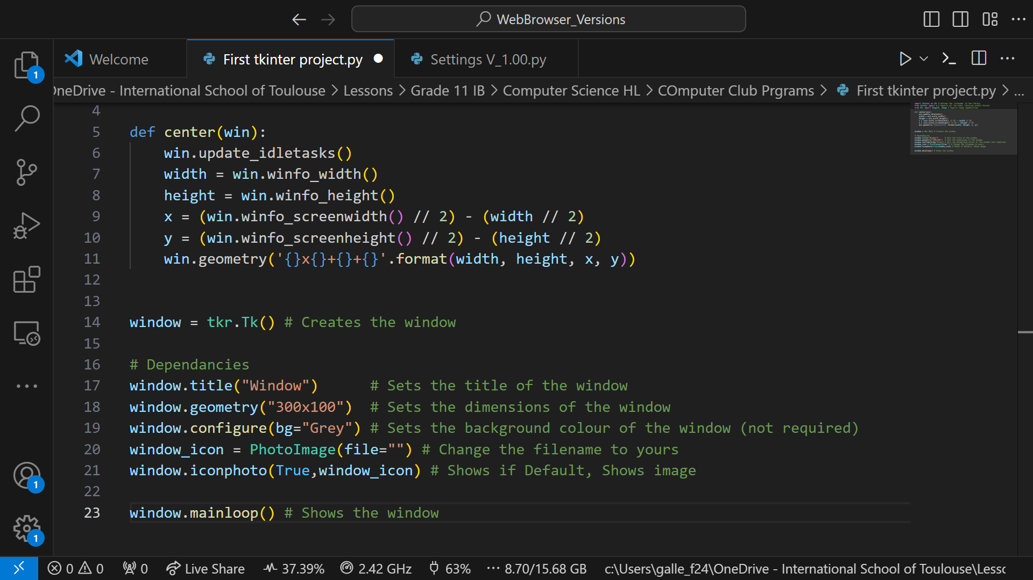
Required if you want the window to run

Slide 17
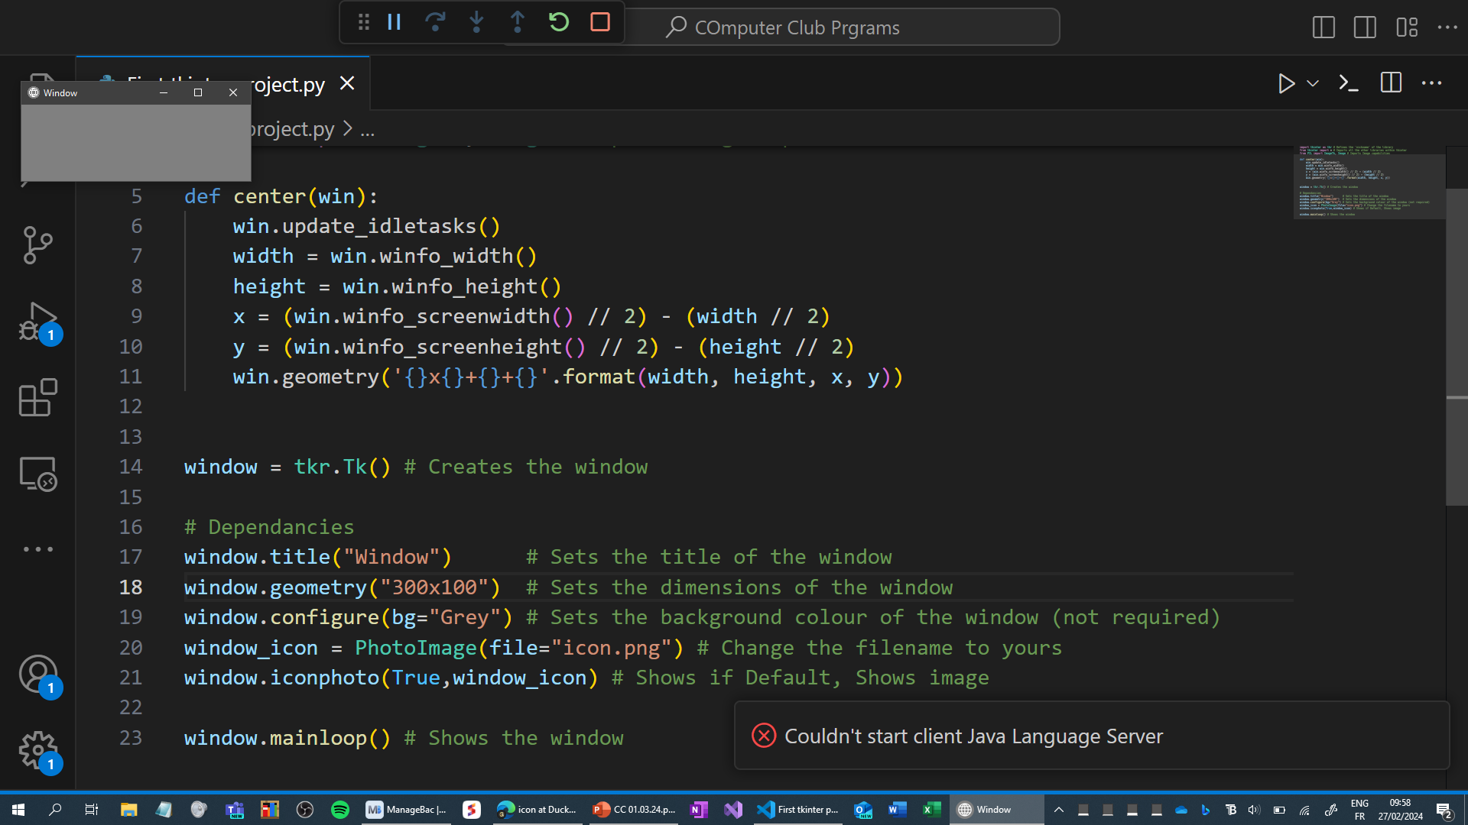
Here is the window.
It isn’t in the middle of the screen because I didn’t use this.

Slide 18
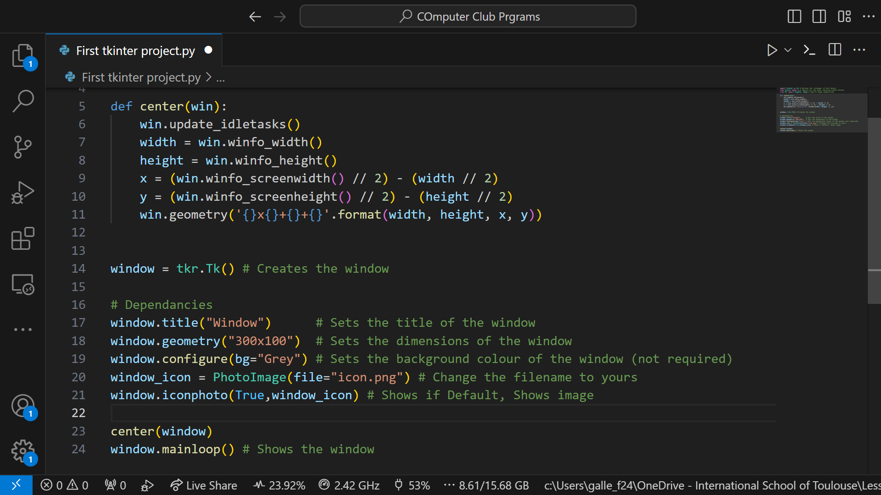
Here is the corrected code.

Slide 19
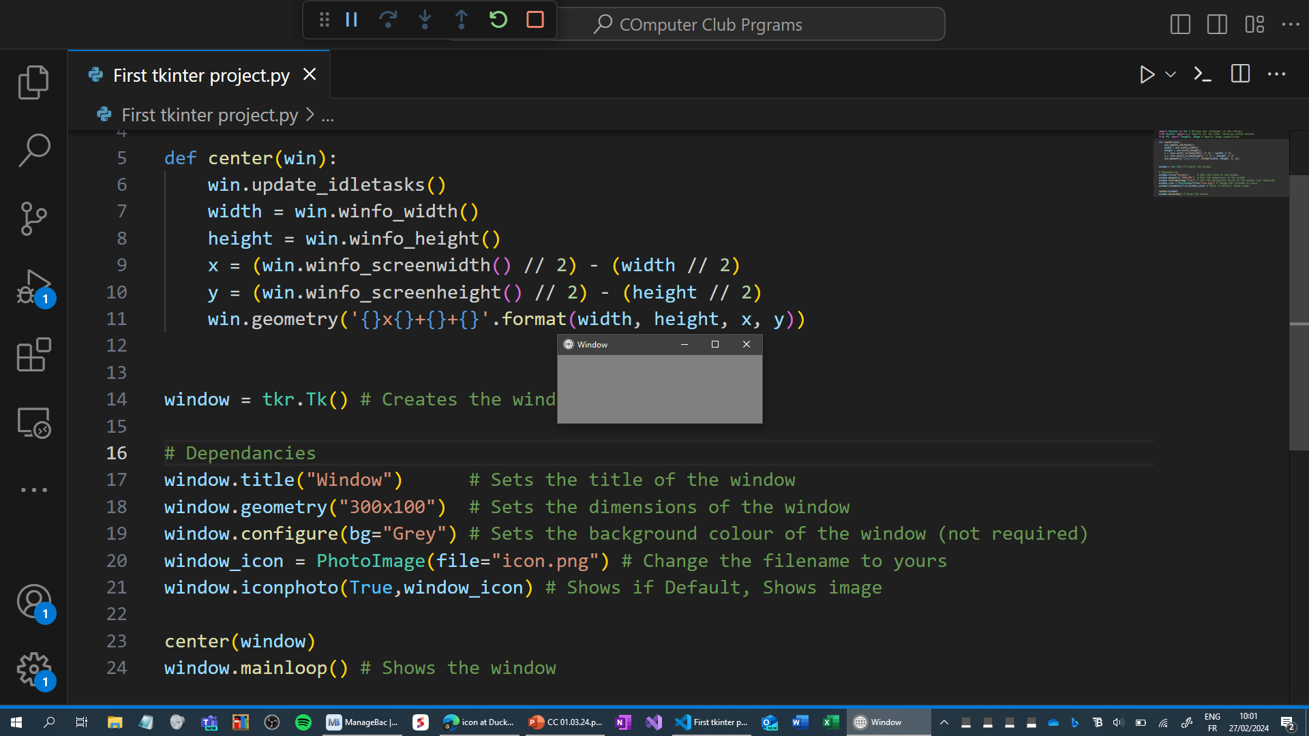
It works!!!

